Slide 1
Analyzing Nobel Prize Laureates
Presentation for : UCACCMET2J Data Analysis for LA&S
Team ‘Easier Said than Run’
Lea Corsetti, Jitske Koeleman,
Daan Sanders & Quirine Smit

Slide 2
Outline
Selecting the right data
Results
Birth years laureates
Alma mater (university) records
Nationalities laureates
Nationalities by Nobel prize category
Joining datasets: world map plotting
Acknowledgements
Q&A
PS: enjoy the memes

Slide 3

Making the Database of Nobel Prize Winners
Successful Try 1
Key = "award_label"
Search term = “nobel”
569 Nobel laureates
Successful Try 2
Key = "22-rdf-syntax-ns#type_label"
Search term = "nobellaureate"
Combination
848/892 Nobel laureates

Slide 4
Limitations of the Dataset
How correct is our list?
Missing 44 individuals
Typo’s, not encoded in Wikipedia
Not everyone is a Nobel Prize winner
Holly Walsh
Mislabeling
Excluded ‘Ig Nobel Prize’
Someone actually won both
Outside dataset
Not enough time

Slide 5
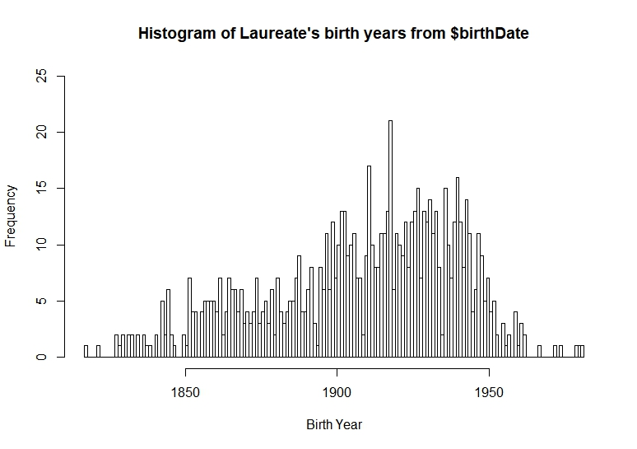

Birth years
To try working with the data set
To compare the data columns
birthDate Year and birthDate Date
Is there a fairly equal distribution in laureate birth year, and does the answer differ per data column?
Also: #teamdoggo

Slide 6
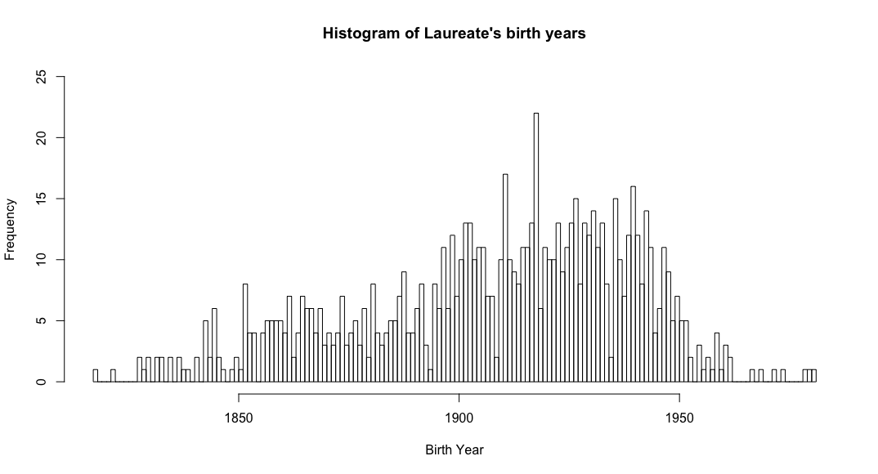
The comparison
from the birth date column from the birth year column

Slide 7
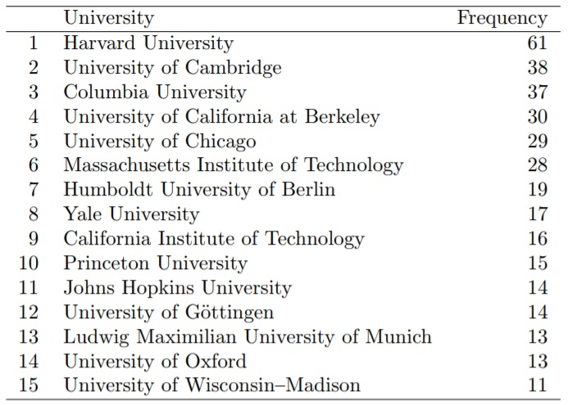
Alma Maters
Which universities have the most Nobel laureates as former students?
Data set difficulties
Empty/incomplete entries
Subsidiaries of universities (e.g. Harvard Law School)

Slide 8
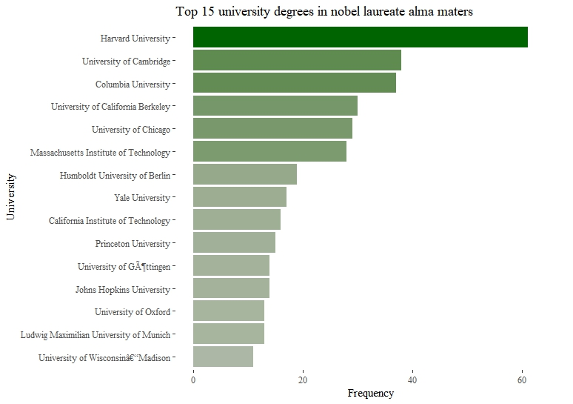
Alma Maters
Creating a graph for overview
Downside of top-15:
Differences much smaller at +/- 10 graduates
Slight character encoding issue
Dominance of Western universities, especially American

Slide 9
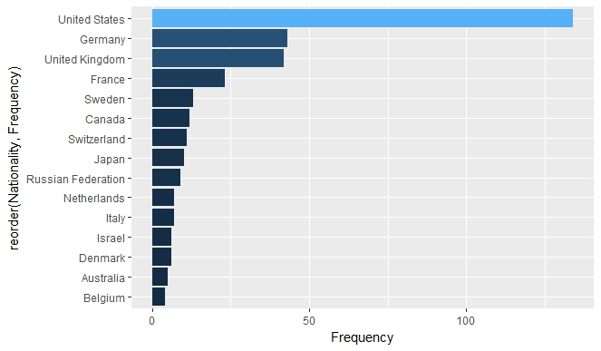
Nationalities
From which states do most Nobel laureates come?
A graph of the top 15 nationalities
Messy data
Notes:
We made a bar graph showing the top 15 nationalities
360 missing nationalities...
Irish people, Ireland
Russia, Russians, Soviet Union, Russian Federation, Russian people

Slide 10
Comparison

Slide 11

American dominance in the data set
Explanations?
Naturalization of foreigners to American citizenship
Overrepresentation of American entries in Wikipedia
Americans simply win more Nobel Prizes

Slide 12
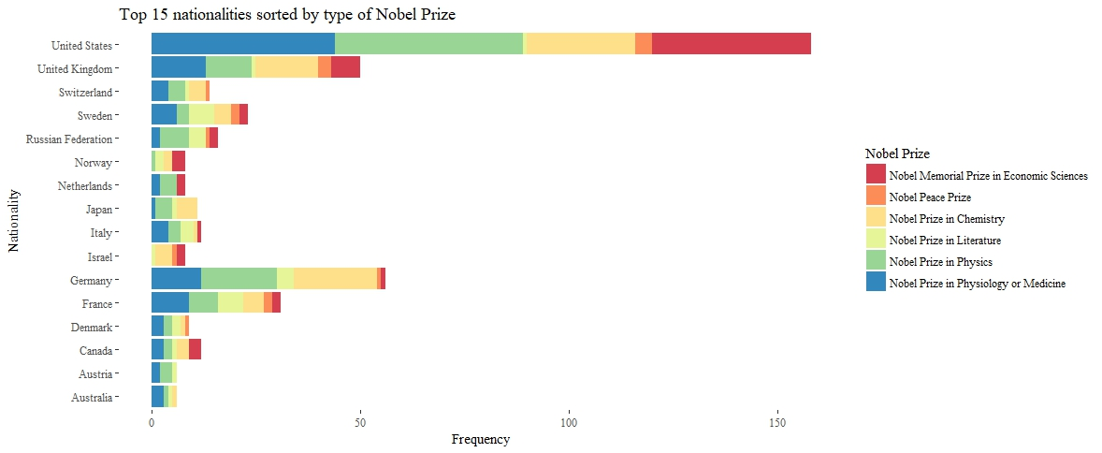
Nationalities, sorted by category
Notes:
Sorted by type of Nobel Prize
Top 15 is mostly Western countries, which receive more academic prizes,
Not so many non-western countries which are more likely to get the Peace prize in conflict countries.

Slide 13


Using External Datasets: extinguishing (and lighting) more fires
External dataset that contained longitude and latitude for each nation
Combined the dataset with nobel prize dataset (most up to date version thereof)
Making a new file that plotted the frequency of laureates from each country
Desired end result: plotting a map containing dots marking the countries which boast a nobel laureate, size for number of nobel laureates.

Slide 14
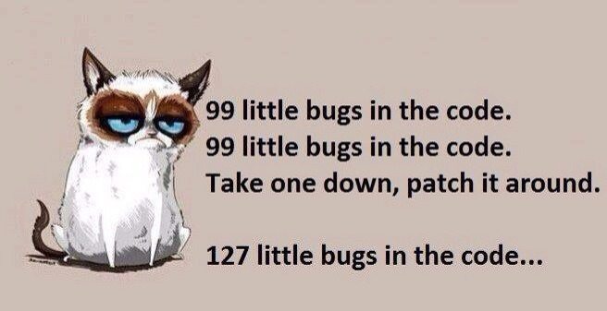

Slide 15
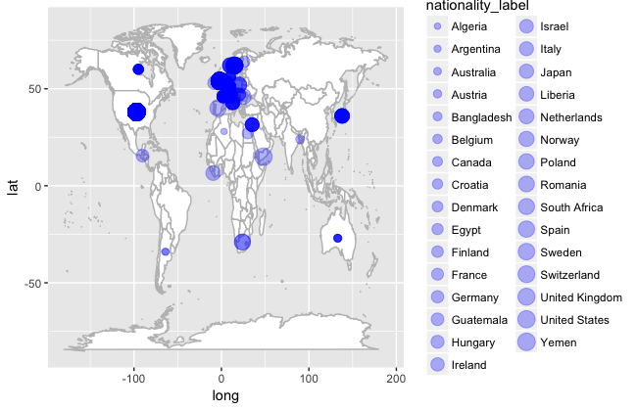

Slide 16
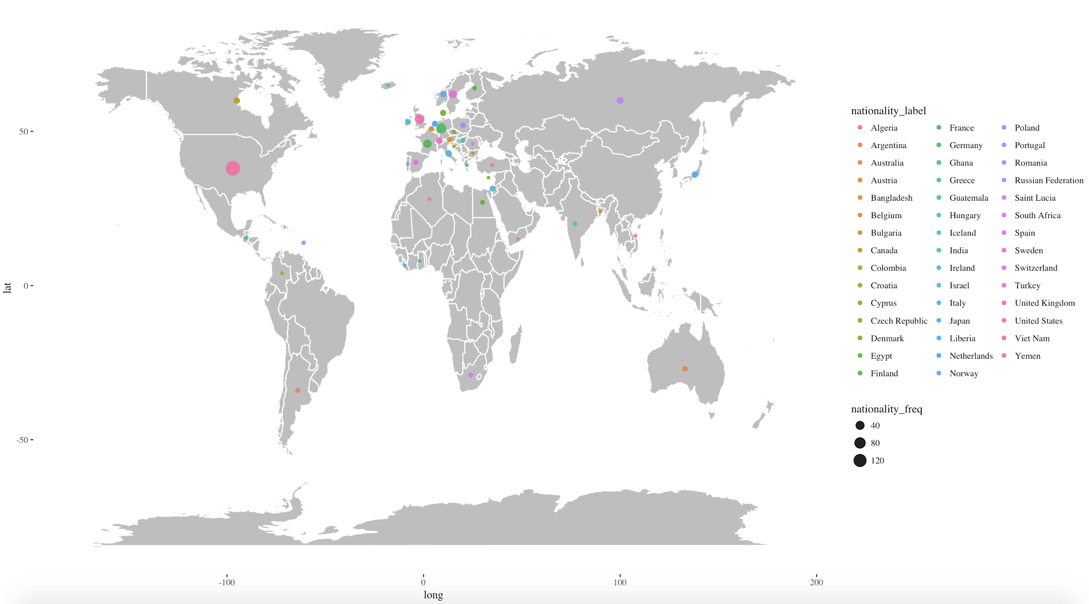

Slide 17
Conclusions
Data much more difficult to work with than expected
Much of the time spent on cleaning and structuring the data sets
Frequencies relatively inaccurate
General conclusions quite accurate
Strong dominance of Western countries and universities, especially the USA

Slide 18

Acknowledgements
Special thanks to Joska, Lucie and Teun
(and Google)
(and StackOverflow)
(and Wikipedia)

Slide 19

The end

Slide 20

Testimonies
“I entered VIM, did what I wanted to do, and then exited VIM! That was my proudest moment of the course”
Quirine
“I never thought I would hold Teun’s brain in my hands.”
Jitske
“Course achievement: making a histogram that worked on first try and (consistently) afterwards.”
Lea
“I’m still fascinated by how, when my code wouldn’t work, Lucie would walk over, and the exact same code worked fine. Unicorn powers, probably…”
Daan

